Slide 1
Presentation on
Maharashtra State’s SMS Gateway
1

Slide 2
SMS Gateway Solution by MahaOnline
PUSH-data sent to respective end user from application or Web-service through SMS,
PULL Data service–data received from various end user(citizen or departmental user) through SMS to MahaOnline long code or CDAC short code.
MIS SMS Report
Server Infrastructure hosted in MH SDC
Technology used : Java, Web-service, RESTFul Web-service, MySQL & SQL Server-2008
Long Code : 9222200022
Sender Name : TA-MAHAOL
Short Code : 166 / 51969
Sender Name: TD-MAHGOV

Slide 3
Salient Features of SMS Gateway
Authentication, Authorization & Audit Trail Maintained
New User Creation
New Group Creation– new group can be created to map multiple users under same group
Unicode Support- the SMS gateway is in bi-lingual form
Simple and User Friendly GUI
Web-service Utility– can be integrated with different applications through web-service
Audit Trail Maintenance—audit trail report for each message log is maintained
MIS Report Generation– as per department requirement various MIS Reports are generated

Slide 4
Functions
PUSH Services
User Friendly GUI
Sending Information
Notices
Updates & Alert
Web-service Utility
Integrates with the Departmental Application to consume SMS gateway web-services e.g. System Generated SMS like Registration Alert, Verification Code etc.
PULL Services
Keyword Registration e.g. PHD, SRDH, RTO etc.
Finalize the message syntax
User to send the message to MahaOnline long code (9222200022) or
CDAC short code (166 / 51969).
User will receive an acknowledgment in response with unique token number.
MIS SMS Report
Customized report which can be exported to Excel, PDF or can be printed
online.

Slide 5
SMS Gateway – Architecture

Slide 6
Why to adopt SMS solutions in Governments
There are several initiatives to adopt e-government functions based on the Internet worldwide even in developing countries to ensure easy access and availability. Very often these initiatives failed and among the reasons there were problems such as low internet access, high Internet costs and Internet illiteracy among citizens and even among workers at governments. Furthermore, email messages are not surely read immediately and it is a critical problem in case of emergencies or disasters.
These features can be achieved by powerful SMS gateway software such as MahaOnline SMS Gateway. This software product will provide SMS functionality to be able to send bulk SMS messages to multiple recipients. Therefore you can reach high performance & efficiency, improve communication, paper less technology, availability and access to governmental services.

Slide 7
What advantages are provided by SMS Gateway
Problems | Solutions provided by MahaOnline SMS Gateway
Continuous communication cannot be maintained between offices and people on the field in case of emergency | Build a stable SMS system to ensure seamless communication flow among departments and on the fields
Citizens do not report new pot-holes because it is too time-consuming | Offer SMS reporting system that is time and cost efficient
There are too many damage on the roads, lodge complaint, get Status of any application, etc | The solution is an SMS reporting system or PULL SMS service
There are long waiting queues in front of offices (e.g. employment offices) | SMS notifications about new jobs, services, fines, etc), so people can receive information at home or on the move
There are lots of harms and work stoppages because of system breakdowns | Add SMS extension to the monitoring application to send SMS alerts in real time

Slide 8
Departmental Solutions-PUSH GUI Service
Department of Information Technology (DIT)
Food & Civil Supplies Department (FPS)
Shree Siddhivinayak Ganapati Temple Trust (SVT)
Directorate General of Information and Public Relations (DGIPR)
Collector Office, Aurangabad
Collector Office, Nandurbar
Collector Office, Sindhudurg
Zilla Parisad, Sindhudurg
e-Panchayat MahaOnline Team

Slide 9
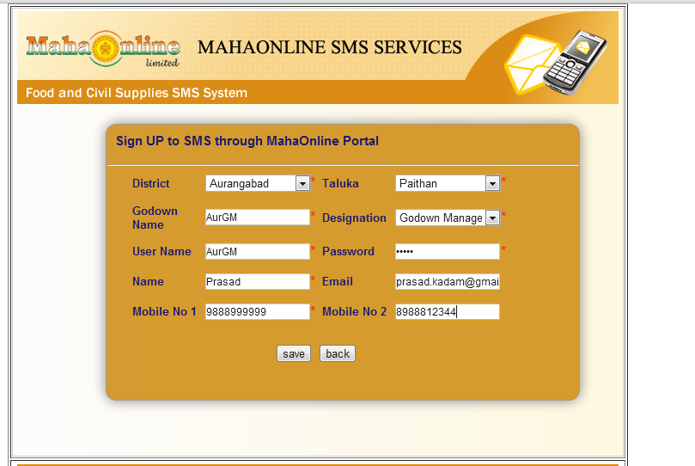
Food & Civil Supply-User Creation

Slide 10
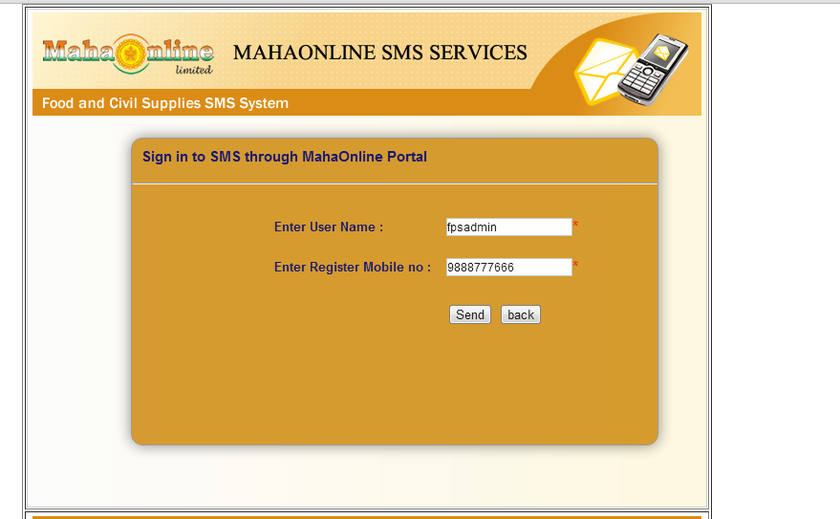
Forgot Password

Slide 11
Change Password

Slide 12
Template creation for Message

Slide 13
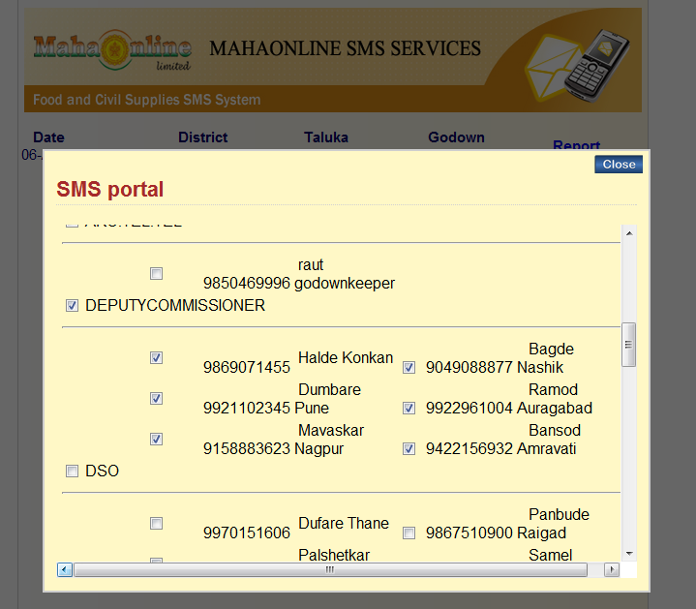
Group User

Slide 14
Send SMS

Slide 15
Departmental Solutions- PUSH Web-Service for system generated SMS
Maharashtra State Excise, Dept.
Minute of Meeting application
e-Complaint application
CM Dashboard application
Digi-Gov application
Lokrajaya Subscribe application
Purchase Order application
Alert & Response Disaster Management System.
e-Pani application
IDOL application
Maharashtra Suger Information System
Finance department application

Slide 16
PUSH Web-service format
Web-service URL
http://gateway.mahaonline.gov.in/MOLSMS/services/PushSMS?wsdl
Method name is MOLPushSMS (userName, passWord, strMobileNo, msgBody, smsId, langId)
userName : cdacdemo
passWord : xxxxxxx
strMobileNo : Mobile no should be 10 digits OR comma separated.
msgBody : Message body (i.e UTF-8 support)
smsId : 0 (by default pass zero value only for system generated SMS like registration, verification & etc...).
langId: 1- for CDAC and 2- for TCIL service provider
CDAC & TCIL are supporting bi-lingual language.

Slide 17
Departmental Solutions- PULL Service
Public Health Department (PHD, MMU, SHP & PHC)
e-Maha Bhoomi application (eMB)
State Transport Department (RTO)
Property Tax & Water Bill (MNET)
State Resident Data Hub (SRDH) of Aadhar
Institute of Distance & Open Learning (IDOL)
Document Journey Management System (DJMS) and File Status Tracking.

Slide 18
Public Health Department
Hospital Program Pull SMS (PHD)
Objective:
To gather information on a daily basis about various parameters from Hospitals.
Coverage:
All District Hospitals, General Hospitals, Women Hospitals, Sub-District Hospitals and Rural Hospitals.
Frequency:
Once daily at 9 A.M.

Slide 19
Public Health Department
Responsibility:
PHC Medical Officer-In-Charge
Format:
PHD 1203 OPDO 13 OPDN 400 IPDO 57 IPDN 10 DIS 20 RO 1 RI 3 DTH 3 DEL 50 IUDSB 2 LSCS 25 MS 10 NICUA 5 NICUD 1 PM 20
Above message send on MahaOnline long code 9222200022.
Acknowledgment:
User will receive response of acknowledgment with unique token number from SMS Gateway.

Slide 20
State Transport Department (RTO)
Complaint lodge by SMS
Format:
RTO<space>Auto/Taxi<space>VehicalNo<space>Reason
e.g.
RTO T 03 AS 3080 RF
Send on MahaOnline long code 9222200022

Slide 21
State Resident Data Hub (SRDH) of Aadhar
Getting UID number by using PULL SMS
Seeding UID number with Citizen Services
Format:
SRDH<space>MYUID
SRDH<space>SEEDUID<space>LPG<space>987653
SRDH<space>SEEDUID<space>PDS<space>67542
e.g.
SRDH MYUID
Send on MahaOnline long code 9222200022

Slide 22
e-Maha Bhoomi (eMB) department
1. Talathi will send SMS to MahaOnline long code
eMB<space><8-digits village code>
2. SMS Gateway will push message to e-Maha Bhoomi application by using web-service.
3. e-Maha Bhoomi response to MOL SMS Gateway
4. Talathi will receive SMS e.g. (Village code, request id, Send for Confirmation (SFC)?)
Message look like (eMB 03050600, 451, SFC?)
5. Talathi will update the message
eMB<space><8-digits village code>, <request-id>, YES

Slide 23
e-Maha Bhoomi (eMB) department
6. Talathi will finally receive e-Mutation number by using SMS
e.g. (village code, request id, mutation number)
(03050600,451,75)

Slide 24
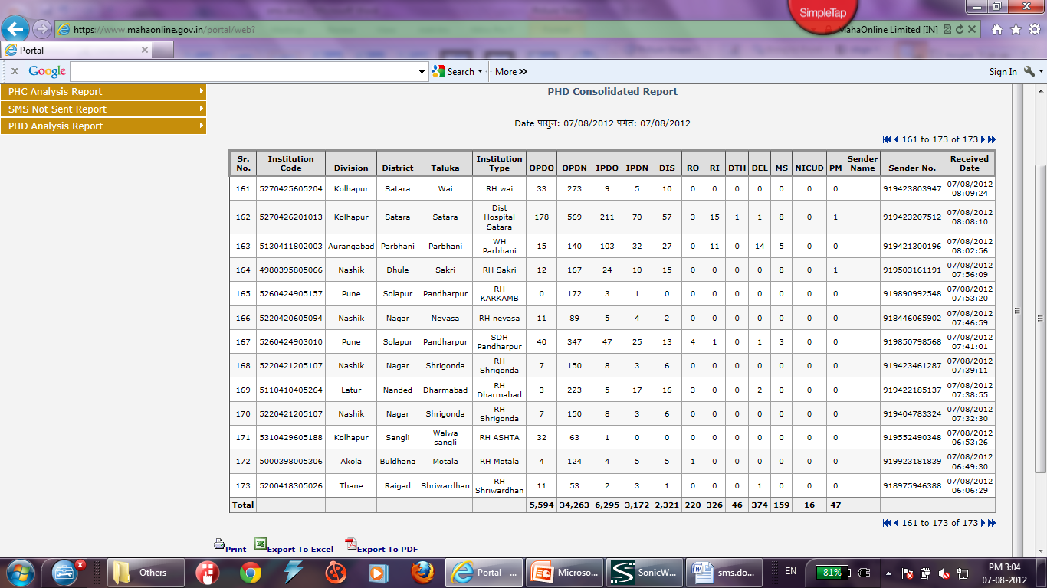
MIS Report
Public Health Department

Slide 25
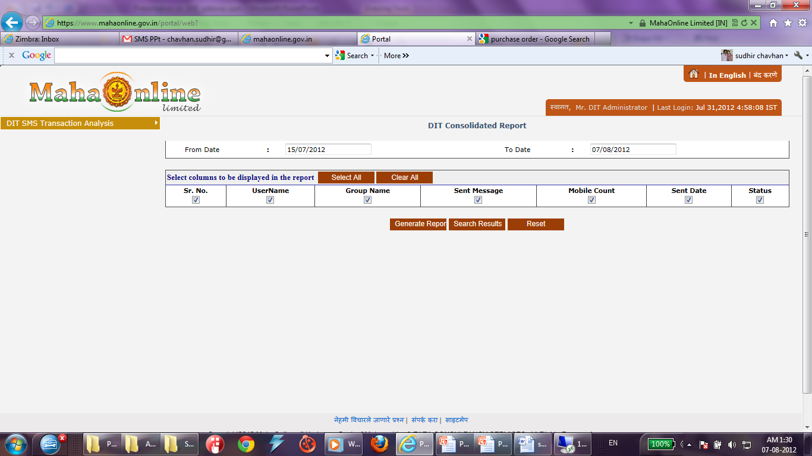
MIS Report
Department of Information Technology

Slide 26
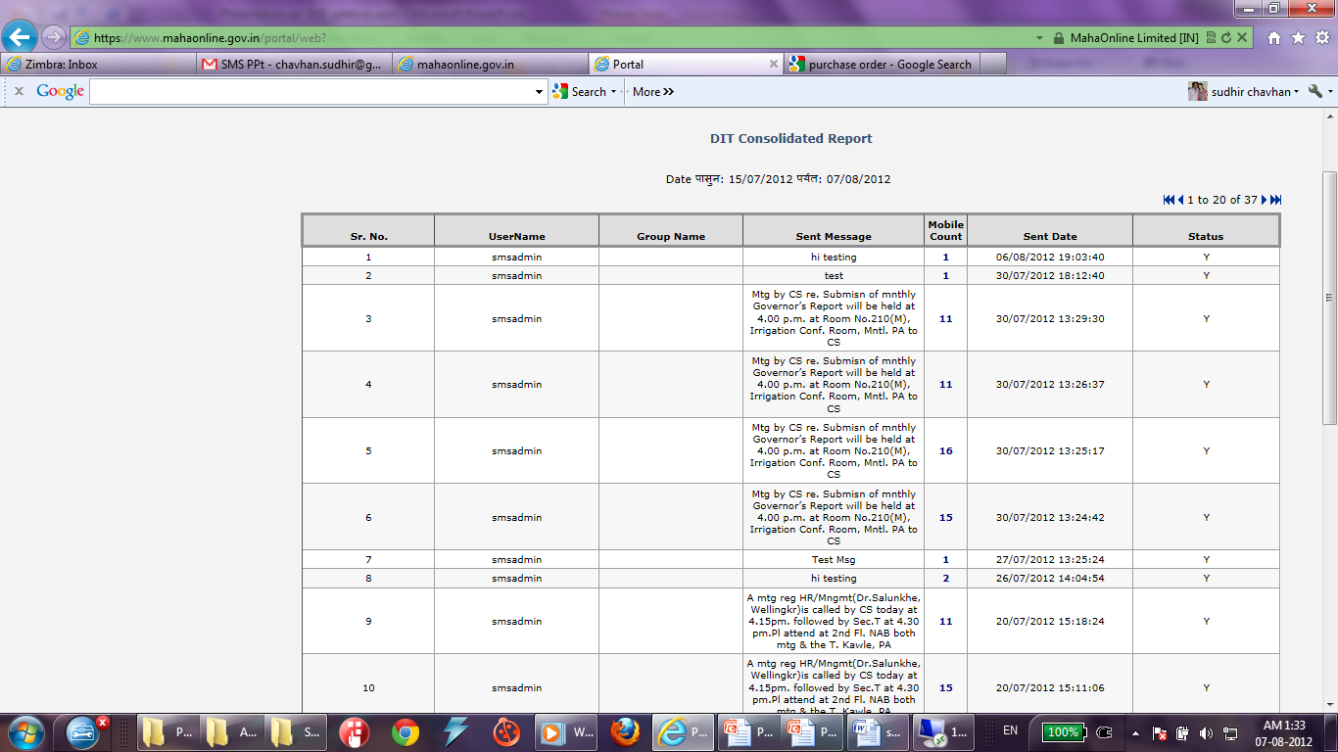
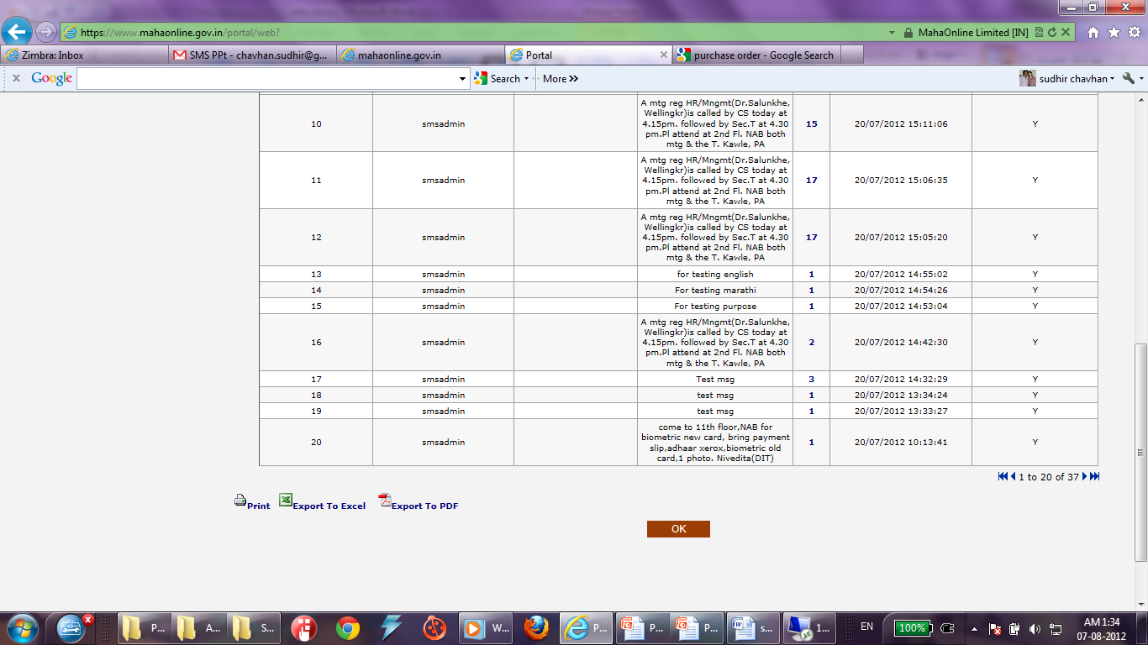
MIS Report-DIT

Slide 27
Thank You

